Slide 1

Cannabis Usage in Canada Post-Legalization
Alex Natis

Slide 2
Abstract
This project will assess the impact of the legalization of cannabis in Canada on cannabis usage patterns in the population. Cannabis was legalized in Canada in October of 2018. Specifically, we are looking to see if there was a surge in cannabis users immediately following legalization and determine if there are any trends regarding cannabis usage following legalization. This analysis will provide insights into the long-term effects of cannabis legalization on usage trends and help inform public policy and healthcare strategies related to cannabis consumption going forward.

Slide 3
Data Sources
- Data was retrieved from Statistics Canada pertaining to cannabis usage across Canada.
- The data is collected via a survey, asking participants if they have consumed cannabis in the previous 3 months, meaning the data is self-reported and may not be entirely accurate.
- The data timeline spans from 2018 Q1 to 2020 Q4 with data missing from the first, second, and third quarter of 2020.
- The data is segmented by province, sex, and age allowing for analysis from a variety of perspectives.
- The data for Canadian territories (Yukon, Northwest Territories, and Nunavut) is sparse so these locations will not be included in the analysis.

Slide 4
Business Questions
• Did cannabis usage surge immediately following legalization?
• If there was a surge, was it sustained, or did it gradually decrease over time?
• Were specific demographics disproportionately affected by legalization
• What are the potential long-term implications of cannabis legalization on usage trends?

Slide 5
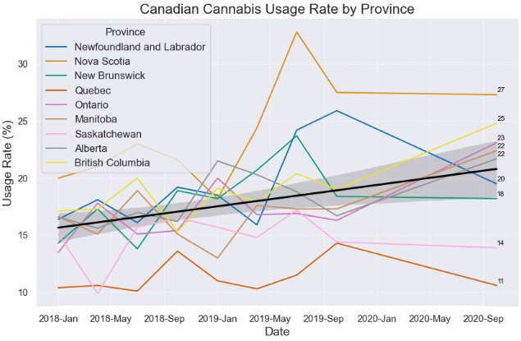
Changes at the Provincial Level
- Cannabis usage rate is increasing across the country
- Some provinces saw a surge in users post-legalization, but not all
- Some provinces have seen a pull-back after the surge while others have continued to rise

Slide 6
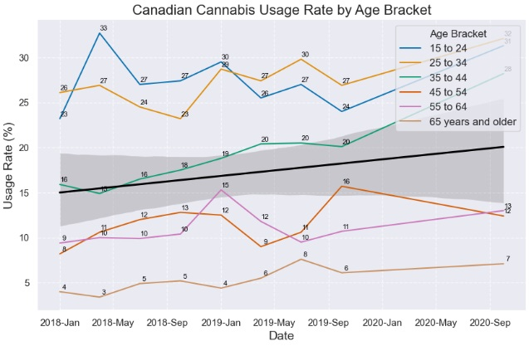
Age Bracket Influence
- All age brackets have seen an increase in users
- The majority of users are below the age of 45

Slide 7
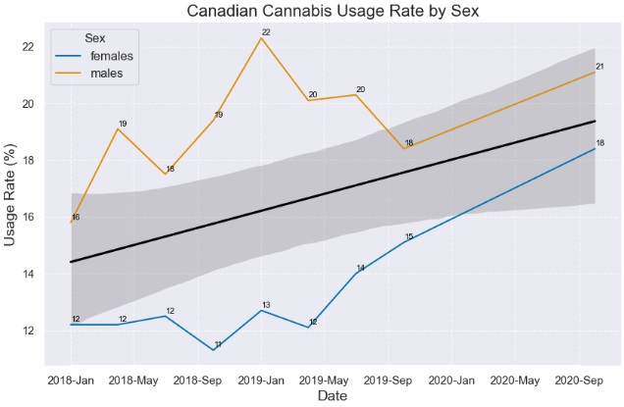
Sex as an Indicator
- Both sexes show similar levels of growth since legalization
- Males experimented sooner than females post-legalization

Slide 8
Business QuEstion Answers
• Did cannabis usage surge immediately following legalization?
- Yes, particularly among males.
• If there was a surge, was it sustained, or did it gradually decrease over time?
- Large surges experienced pull back but there are signs for sustained long-term growth.
• Were specific demographics disproportionately affected by legalization
- Youth were already partial to cannabis, legalization opened the floodgates.
• What are the potential long-term implications of cannabis legalization on usage trends?
- Cannabis usage is expected to continue to rise as it becomes more widely accepted

Slide 9
Conclusions
• Cannabis usage is on the rise across the country
• Sex and age appear to be more influential than geography in how users approach cannabis
• Cannabis users tend to be younger than 45 years of age
• The proportion of cannabis users among Males and Females has grown equally since legalization

Slide 10
References
“Prevalence of Cannabis Use in the Past Three Months, Self-Reported.” Government of Canada, Statistics Canada, Government of Canada, Statistics Canada, 21 Apr. 2021, www150. statcan.gc.ca/t1/tbl1/en/tv.action?pid=1310038301&cubeTimeFrame.startMonth=01& cubeTimeFrame.startYear=2018&cubeTimeFrame.endMonth=10&cubeTimeFrame.endYear= 2020&referencePeriods=20180101%2C20201001.

